Slide 1
CS 4530: Fundamentals of Software Engineering Module 6, Lesson 2 Ethics, Trust & Safety
Rob Simmons
Khoury College of Computer Sciences

Slide 2
Code is Not Morally Neutral

Slide 3
Badly-engineered software can kill people
Therac-25 (1985-1987)
Bug in software caused 100x greater exposure to radiation than intended
At least 6 died
Likely far more suffered: deaths occurred over a period of 2 years!
Weak accountability in manufacturer’s organization
“Therac-25” by Catalina Márquez, Wikimedia commons, CC BY-SA 4.0
https://ethicsunwrapped.utexas.edu/case-study/therac-25
Notes:
A bug in the software controlling the THERAC-25 radiation treatment machine resulted in the death of at least 6 patients, and administered countless additional overdoses. Investigations after-the-fact found that the manufacturer had extremely poor software development and quality assurance processes, without independent code review, without testing, and without safety checks. The machine operators were assured that overdoses were impossible - software was reused from older machines which had hardware interlocks to prevent these software defects from being catastrophic. Note that one result of this incident is stronger standards for safety-critical (in particular: medical) software, which now require rigorous quality assurance practices. The manufacturer of the machine, however, could have easily prevented further damage had they immediately detected and resolved the bug after the first reported incident in 1985.
Discussion Questions:
1. Who should be responsible for the errors in a medical device?
2. What moral responsibility do creators of software have for the adverse consequences that flow from flaws in that software?

Slide 4
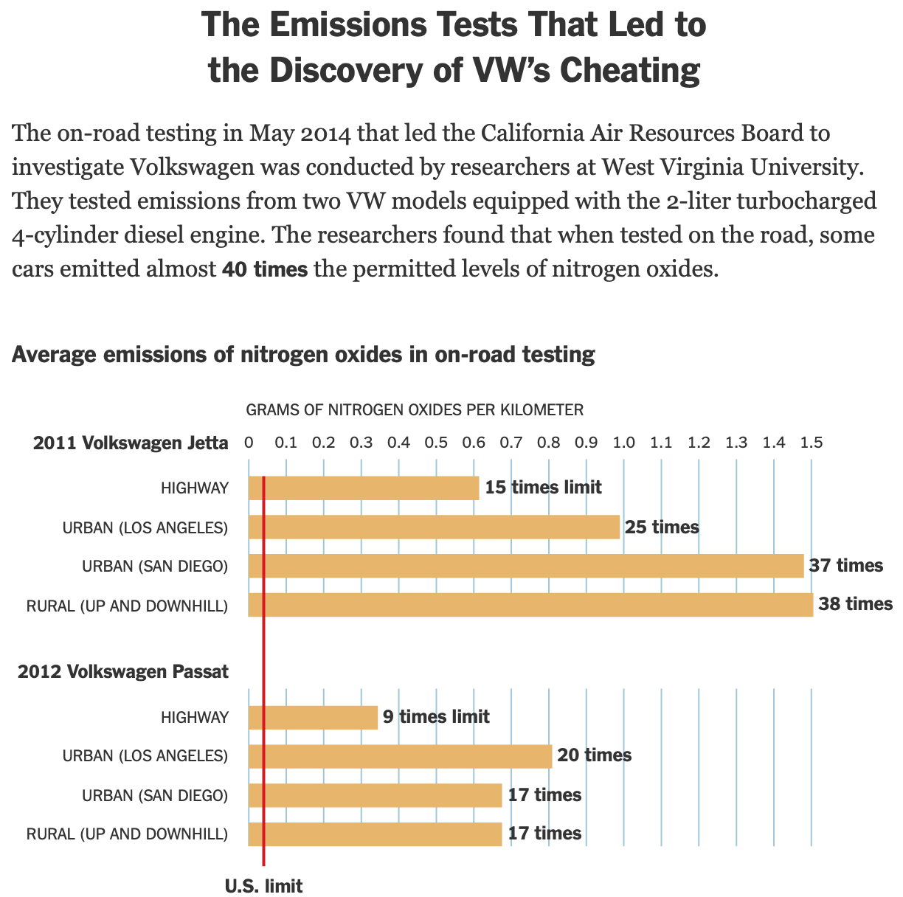
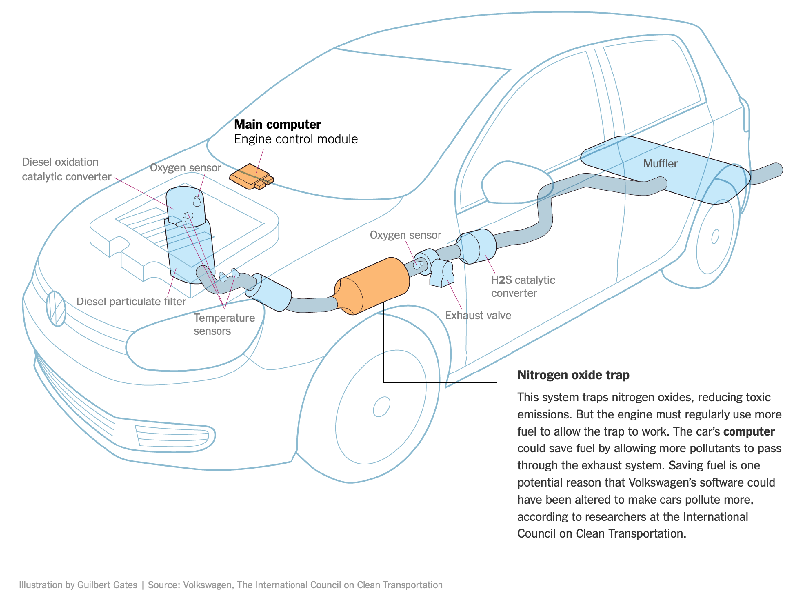
Criming Corporates Need Software Engineers
Example: Volkswagen diesel emissions
$14.7 billion settlement
“How Volkswagen’s ‘Defeat Devices’ Worked” By Guilbert Gates, Jack Ewing, Karl Russell and Derek Watkins
Notes:
It’s hard to talk about engineering equitable software and not bring up the Volkswagen emissions testing defeat device. If you’re not familiar with this scandal: cars are held to a particular emissions standard. Particularly in diesel cars, reducing emissions often tracks with reducing performance. Again, the question of “how much emissions are too much, if any” is out of scope for this discussion, and instead, we’re focusing on the regulations that existed at the time of this scandal. Cars are tested for this emissions standard in off-road simulators, where they can be easily hooked up to equipment that directly measures their emissions. Volkswagen’s engine control unit had customized software to detect when the car was under an emissions test and tune the engine to reduce performance and emissions, resulting in emissions tests that significantly under-represented the actual emissions of the vehicle. (Click) This software mislead regulators and consumers, and ultimately Volkswagen agreed to spend $14.7 billion in a settlement, and was subject to significant public relations damage.

Slide 5
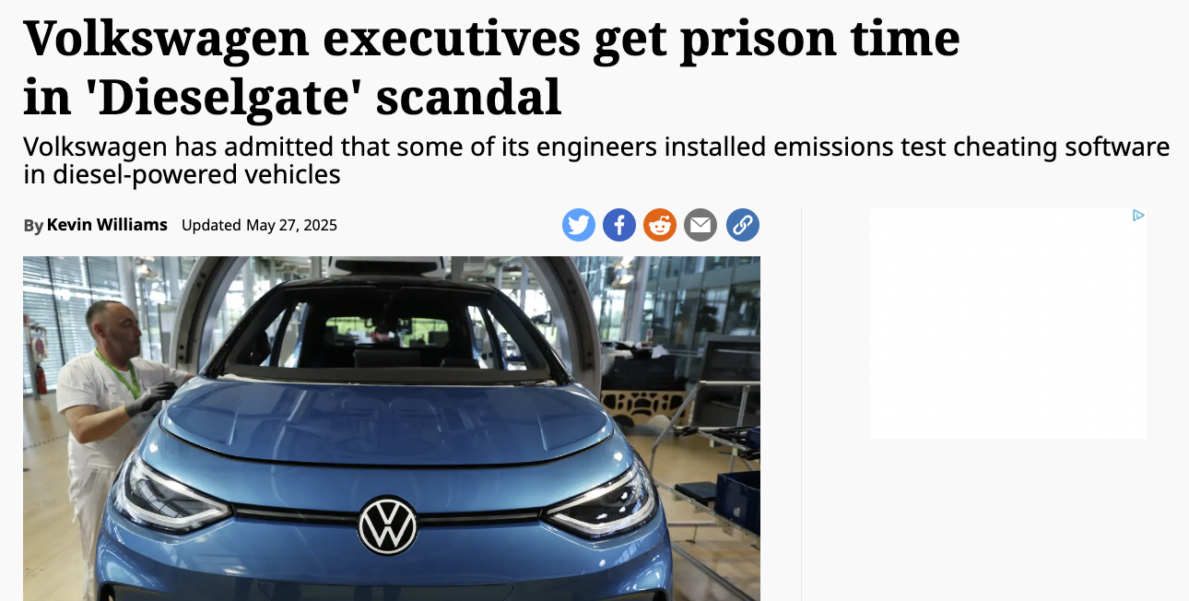
Criming Corporates Need Software Engineers

Slide 6
ML (&LLMs&etc) Reinforce, “Launder” Bias
The COMPAS sentencing tool discriminates against black defendants
 | ALL | WHITE DEFENDANTS | BLACK DEFENDANTS
Labeled High Risk, But Didn’t Re-Offend | 32% | 23% | 44%
Labeled Low Risk, Yet Did Re-Offend | 37% | 47% | 28%
Analysis of Broward County data: “How We Analyzed the COMPAS Recidivism Algorithm” by Larson et al.
Notes:
Some states use software to assess a criminal defendant’s likelihood of recidivism - a term used to describe criminals who are likely to re-offend. This prediction is used in pre-trial bail hearings, and also in sentencing, where the goal is to assign longer sentences to those most likely to commit another crime. It is likely not unreasonable to be concerned that some judges might be biased against certain defendants, and assign harsher sentences based on those biases. If computers can accurately predict which defendants are likely to commit new crimes, we could potentially reduce bias in our criminal justice system.
Here are the results of an evaluation of one model, the COMPAS Sentencing Tool in Broward County, Florida.
The percentage of false positives and false negatives was roughly 30% in both ways (not great, in any case!)
But if you break down this data by race, you see that black defendants are far more likely to be falsely labeled as high risk than are white defendants. (And vice versa: white defendants are far more likely to be falsely labeled as low risk)
When building such tools, it’s vital to evaluate them on multiple dimensions to ensure that we are not simply re-enforcing existing biases.

Slide 7
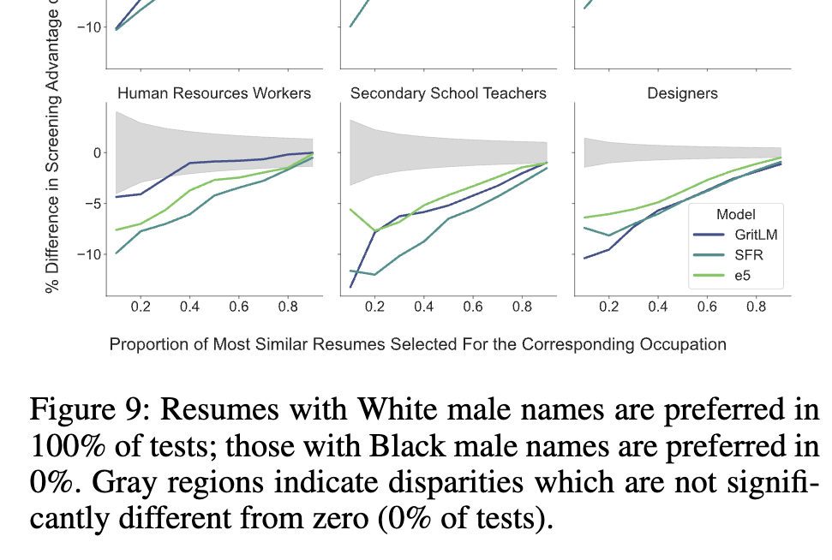
ML (&LLMs&etc) Reinforce, “Launder” Bias
Biases lead to people with white names getting hired more
System trained on who got hired in the past
Machine learning algorithms can be great at teasing out how we’re actually making decisions (sometimes badly!)
Kyra Wilson & Aylin Caliskan, “Gender, Race, and Intersectional Bias in Resume Screening via Language Model Retrieval”
https://ojs.aaai.org/index.php/AIES/article/view/31748

Slide 8
Code is Not Morally Neutral
“Here we illustrate the point that algorithms themselves can be the source of bias with the example of collaborative filtering algorithms for recommendation and search.”
Bias in collaborative filtering, Catherine Stinson, AI and Ethics Volume 2, 2022
https://link.springer.com/article/10.1007/s43681-022-00136-w

Slide 9
Stable Matching and the NRMP
“When residencies were first introduced, around 1900, hospitals began competing with one another to secure the best residents as early as possible. By the 1940s, positions were being offered in the third-year of medical school. Students were making career decisions without adequate exposure to their options, and hospitals were making hiring decisions with little data.”
https://pmc.ncbi.nlm.nih.gov/articles/PMC3399603/

Slide 10
Stable Matching and the NRMP
1952 National Resident Matching Program — big centralized assignment of residents to programs.
Stable Matching is a property of weighted graphs: if Jimmy gets assigned to Mass General but would prefer Emory University, Emory prefers everyone assigned to them over Jimmy. (No defections.)
Algorithm naturally has “proposers” and “acceptors,” and generalizing how applications generally work, natural to make potential applicants the proposers.
Notes:
The decision to use an algorithm — even for good reasons! — is not morally neutral.

Slide 11
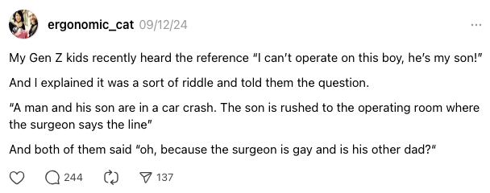
Stable Matching and the NRMP
Two problems
Multiple stable matchings usually exist. That “natural, obvious” choice leads to the best outcomes for hospitals, and the worst outcomes for students.
Not a lot of medical couples in 1952! Stable matching as a centralized solution assumes individual preferences make sense for families.

Slide 12
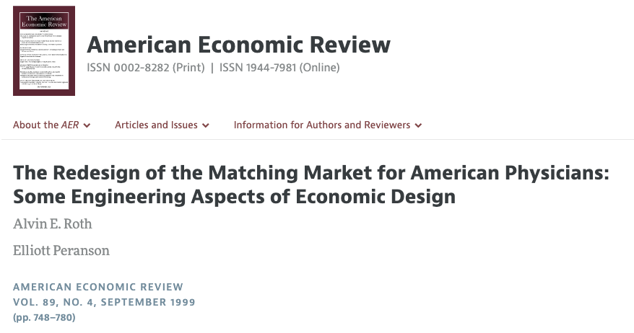
Stable Matching and the NRMP
https://www.aeaweb.org/articles?id=10.1257/aer.89.4.748

Slide 13
Code is Not Morally Neutral

Slide 14
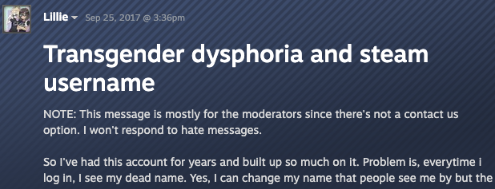
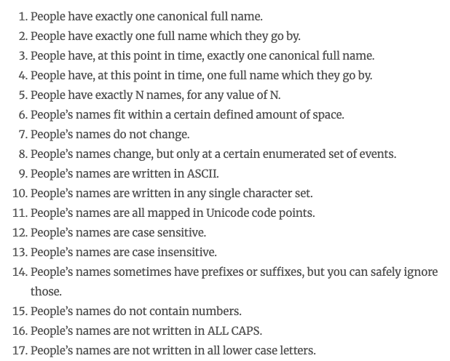
Even Database Schema are Not Morally Neutral!
https://steamcommunity.com/discussions/forum/1/1496741765144289150/
https://www.kalzumeus.com/2010/06/17/falsehoods-programmers-believe-about-names/

Slide 15
Code is Not Morally Neutral
To be sure:
Bad engineering can kill unintentionally (Therac)
There’s “bias” (in the technical and non-technical sense) in machine learning algorithms
Good engineering can kill people intentionally (pick your good/bad/evil/noble country or Military-Industrial Complex employer as you prefer)
But in some sense, that’s the obvious bit!

Slide 16
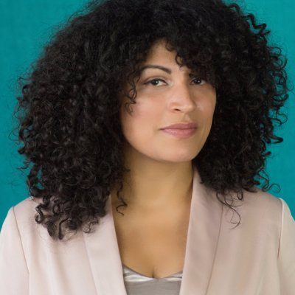
Code is Not Morally Neutral
One mark of an exceptional engineer is the ability to understand how products can advantage and disadvantage different groups of human beings
Engineers are expected to have technical aptitude, but they should also have the discernment to know when to build something and when not to
Demma Rodriguez Head of Equity Engineering
Google
Quote: “Software Engineering at Google: Lessons Learned from Programming Over Time,” Wright et al, 2020 (O’Reilly)
Notes:
Being an exceptional engineer means not only that you know HOW to build some great features, but that you have the judgement to be able to identify and reject features or products that drive adverse outcomes.

Slide 17
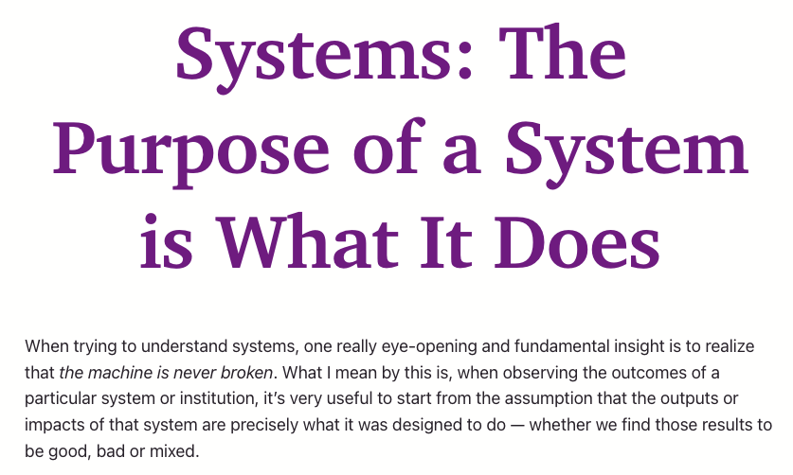
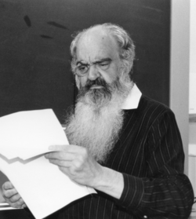
The Purpose of Code is What it Does
Stafford Beer, “management cybernetics”
https://en.wikipedia.org/wiki/Stafford_Beer
https://www.anildash.com/2024/05/29/systems-the-purpose-of-a-system/
Notes:
POSIWID is described as a “heuristic,” it’s intentionally provocative.
Obviously it’s not precisely true — the purpose of the US medical system isn’t to prevent exactly 2/3 of people with cancer from dying —

Slide 18
User Stories: Definitely Not Morally Neutral!
Notes:
Discussion points:
- Any time you set limits on what counts as valid discussion, you’re including and excluding some people (re: accessibility as a functional or non-functional requirement)
- Social networks having image tagging features and strongly encouraging them in the product — more accessible for users but sometimes things don’t get shared that otherwise would have!
- What are other places you’ve encountered this?
- What are ways in which your user stories could include and exclude classes of users, and what might those effects be?

Slide 19
Challenges of Social Media
“…content moderation really is the main product of any social network — and if you want to make social better, that’s where you have to start.”
“Earlier this week, X announced it will soon roll out a new function, allowing blocked accounts to still view public posts by users who have blocked them… One commenter wrote, “Big day for stalkers and harassers,” while another stated, “That’s not blocking. It’s supporting stalking.””
https://www.theverge.com/23710406/mozilla-social-mastodon-fediverse-moderation
https://tech.yahoo.com/apps/articles/bluesky-app-trends-elon-musk-172408742.html
Notes:
Is anyone adding features that could be utilized by stalkers? Cyberbullies? What are features that could make strategy.town’s base application safer?

Slide 20
“Trust and Safety”
https://en.wikipedia.org/wiki/Trust_and_safety

Slide 21
There are SE-level mitigations for some of these risks
Form a diverse team
“Tell me you don’t have any ____ on your team without telling me…”
People from diverse backgrounds bring different experiences and different perspectives
Consider human values throughout the project
Be intentional (& flexible) about stakeholders
Rely on standards when possible
Monitor actual usage & misusage, user feedback
This is basically the philosophy of continuous delivery, but remember the McNamara fallacy (what gets measured is what gets done)

Slide 22
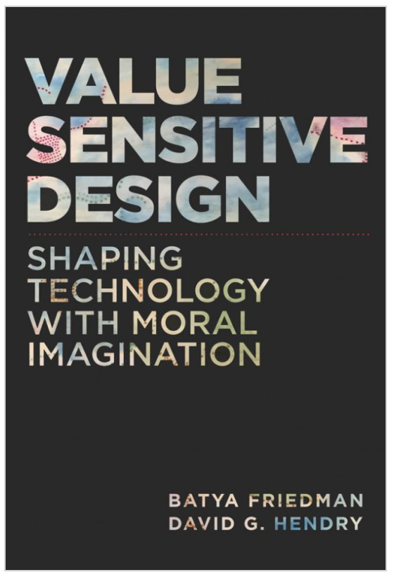
What values might our software promote or diminish?
Human rights - Inalienable, fundamental rights to which all people are entitled
Accessibility - Making all people successful users of the technology
Justice - Procedural justice (process is fair) + distributive justice (outcomes are fair)
Privacy - An individual’s agency in determining what information about them is shared
Human welfare - Physical, material and psychological well-being
Value Sensitive Design @ Khoury

Slide 23
Identifying and Filtering Stakeholders
Direct Stakeholders
Indirect Stakeholders
The sponsor (your employer, etc.)
Members of the design team
Demographically diverse users
Races and ethnicities, men and women, LGBTQIA, differently abled, US vs. non-US, …
Special populations
Children, the elderly, victims of intimate partner violence, families living in poverty, the incarcerated, indigenous peoples, the homeless, religious minorities, non-technology users, celebrities
Roles
Content creators, content consumers, power users, …
Bystanders
Those who are around your users
E.g. pedestrians near an autonomous car
“Human data points”
Those who are passively surveilled by your system
Civil society
E.g. people who aren’t on social media are still impacted by disinformation
People who care deeply about the issues or problem being addressed
Those without access
Barriers include: cost, education, availability of necessary hardware and/or infrastructure, institutional censorship…
Notes:
<summarize/read slide>

Slide 24
ACM Software Engineering Code of Ethics
https://ethics.acm.org/code-of-ethics/software-engineering-code/
. PUBLIC – Software engineers shall act consistently with the public interest.
2. CLIENT AND EMPLOYER – Software engineers shall act in a manner that is in the best interests of their client and employer consistent with the public interest.
3. PRODUCT – Software engineers shall ensure that their products and related modifications meet the highest professional standards possible.
4. JUDGMENT – Software engineers shall maintain integrity and independence in their professional judgment.
5. MANAGEMENT – Software engineering managers and leaders shall subscribe to and promote an ethical approach to the management of software development and maintenance.
6. PROFESSION – Software engineers shall advance the integrity and reputation of the profession consistent with the public interest.
7. COLLEAGUES – Software engineers shall be fair to and supportive of their colleagues.
8. SELF – Software engineers shall participate in lifelong learning regarding the practice of their profession and shall promote an ethical approach to the practice of the profession.

Slide 25
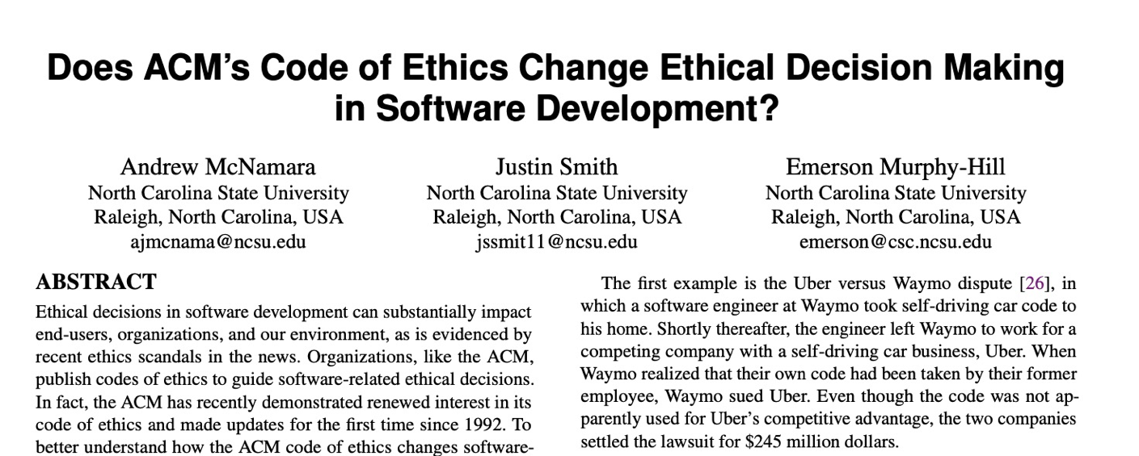
Does this code change developer behavior?
TLDR: No
Notes:
Studies have investigated whether simply exposing engineers to this code of ethics improves ethical decision making in software development
(Click)
(click),
concluding that this code alone does not improve ethical decision making.

Slide 26
Where does this leave us?
So that we can sleep at night
Consider the different ways that our software may impact others
Consider the ways in which our software interacts with the political, social, and economic systems in which we and our users live
Follow best practices, and actively push to improve them
Encourage diversity in our development teams
Engage in honest conversations with our co-workers and supervisors to explore possible ethical issues and their implications.
Also… you just don’t always get to sleep at night.

